Slide 1
2015 Commercial Efficiency and Residential Program & Updates

Slide 2
General Information
Website
www.psegliny.com/page.cfm/Commercial/Efficiency
https://www.psegliny.com/page.cfm/Efficiency
New Office Address: 15 Park Drive, Melville
Mailbox: cepli@pseg.com
Commercial Contractor meetings are every Tuesday and Friday at 9 am
Residential Contractor meetings are every Friday at 9 am
October 29, 2015 Annual Energy Conference
http://energyefficientli.com/register.html

Slide 3
Commercial Efficiency Program (CEP)
Small and Large businesses
Managed and Unmanaged
Commercial Rate codes

Slide 4
Commercial Program Introduction
Purpose of the program
Reduce summertime peak demand (kW)
No outdoor lighting
Program funding
Rate payers through Efficiency and Renewable energy charge displayed on PSEG bill
Notes:
Reduce need to purchase additional energy and build more power plants
How? Through energy efficiency and renewable energy programs that incentive customers to upgrade lighting, hvac, major mechanical, other equipment and installation of renewable energy systems (solar)
Small portion of bill goes towards these energy efficiency/renewable energy programs (determined as percentage of usage)
Other Prescriptive: compressed air, cool roof, VFDs, kitchen equipment, refrigeration
Gut Rehab: substantial renovation to interior (ripping up walls, flooring, etc.); out of commission for 30+ days
For TA Programs, please contact Christine Caruso

Slide 5
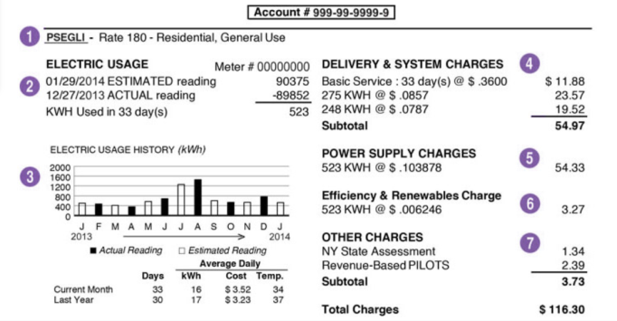
Reading the Bill

Slide 6
Available Programs
New Construction/Gut Rehab
Lighting/LPD
HVAC/Chillers
Other prescriptive measures
Custom
Existing Buildings
Lighting Retrofit
Chillers/HVAC/HVAC Retrofit (DX Systems)
Other prescriptive
Custom Retrofit
Small Commercial Energy Assessments
Available to unmanaged customers with usage under 145kW peak demand (Rate codes 280 and 281s)

Slide 7
New Construction & Gut Rehabs
Fluorescent Strips $15 - $20 rebate for 4’ and 8’ fixtures
HID Fixtures – Lamp $20.00, Fixture $45.00, with remote ballast $45.00
High Bays – Over 25’ $35 to $40.00 for pin based
Recessed Fixtures– Numerous rebates from $5 to $30.00
Refrigeration – Lamp rebates per linear foot $20.00
Horizontal and Vertical lamps as defined in the Design Lighting Consortium (DLC)
Sensors
Ceiling - $35
Daylight Harvesting - $10, - $40
Wall Mounted - $15
Fixture Mounted - $35
HID Sensors
Occ - $75
Daylighting - $75

Slide 8
New Construction LED Lighting Rebates
LED Interior Parking Garage Lighting Fixtures (DLC 5) | $150
LED 1x4 Linear Panel (DLC 16) | $60
LED 2x4 Linear Panel (DLC 17) | $80
LED 2x2 Linear Panel (DLC 15) | $60
Linear Ambient LED Luminaire (DLC 18-21) | $60
LED Low Bay Fixtures (DLC 23) | $150
LED High Bay Fixtures (DLC 22 & 24) | $200
LED Downlights < 1000 lumens (Energy Star) | $60
LED Downlights >= 1000 lumens (Energy Star) | $80

Slide 9
CEP LPD (Lighting Power Density)
New Approved Fixtures must be installed within the space
Table for footcandles is from Ashrae Std. 90.1-2007
Most common
Auto Facility .9 Watts/Sq ft
Dining: Family 1.6 W/Sqft
Gym 1.1
Manufacturing 1.3
Office 1.00
Parking Garage .3
Police/Fire Station 1.00
Religious Building 1.3
School 1.2
Warehouse .8

Slide 10
Rebates Procedure for LPD
No need for preinspection – This is always a new construction
Must Qualify all cuts and determine total wattage
Receive reflective ceiling plans
Submit scaled drawing of reflected ceiling plan.

Slide 11
LPD Calculation
Rebate is calculated as the difference between the baseline Wattage and the Installed Wattage times $0.40 (Tier one) or $.08 (Tier two)
90,000 Square feet
.9 W/Sqft is allowable
therefore 81,000 Watts allowed - Baseline 56,000 Watts - Installed
Reduction is 25,000 W/Sqft enough for Tier two
Tier two is $.80.00
Rebate is $20,000.00

Slide 12
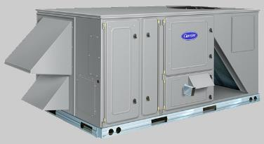
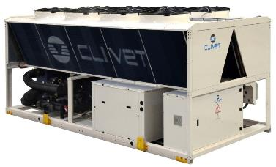
Commercial Energy Efficiency (continued)
HVAC and Chillers
Rebates are available for the replacement of existing units as well as the installation of new units.
Energy Management Systems
Systems must include the control of cooling equipment.

Slide 13
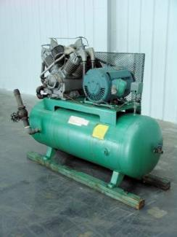
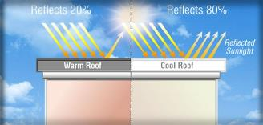
Commercial Energy Efficiency (continued)
Additional Rebates
Air Compressors
Rebates are available for Air compressors, Air Dryers, and Air Storage tanks.
Variable Displacement and Variable Frequency rebates available.
Cool Roof
$0.20/square foot of qualifying product applied.
White roof coatings reflect heat from the sun, keeping the space cooler.

Slide 14
Commercial Energy Efficiency (continued)
Rebate Process
Submit Appropriate Paperwork
Signed Application – Current application is required.
W9 Form – For party receiving the rebate
Equipment Cut sheets – Example: Fluorescent lighting requires Fixture, Lamp, and ballast Cut sheets.
Scope of work – Outlining what is being installed. This should indicate existing equipment as well as proposed.
PSEG Representative will arrange a Pre-Inspection
Once the inspection has been completed and all necessary paperwork has been received, a pre-approval letter will be issued.
Project Completion
Invoice – Should be an itemized invoice indicating what the customer has paid for the work.
Completion Certificate – This form comes from the customer and indicates the pre-approved work was completed.
Post-Inspection
Payment

Slide 15
Program Updates
Existing Building Component
Customers have 180 days from preapproval to completion of project
New Construction and Existing Building Custom Component
Customers have one year from the date of preapproval to completion of project
Lighting Retrofit program revisions
15% Minimum Reduction Change:
<15% yields sliding scale rebate In 2015
PSEGLI Cost Effectiveness Criteria for Demand Reduction
If specific kW targets are not met, rebates will be adjusted through the worksheet

Slide 16
Program Updates (continued)
One for one replacement program
Some configurations will be permitted under Lighting Retrofit Program. Extensive lighting redesigns go through the custom retrofit program
Refrigerated Case Lighting (R100) will be calculated based upon linear feet of case lighting
Reduction in some rebate categories
LED Linear panels
LED High Bay fixtures rebate reduced and clarified
Replacement of T8 fixtures

Slide 17
Project Steps (Pre-Installation)
Send in packaged application
Application, cut sheets, proposal, W-9
Where?
Retrofit mailbox CEPLI@PSEG.COM
Managed account executive
Energy Consultant (EC) or Project Coordinator (PC)
Set up pre-inspection (EC)
Verify existing conditions and gather other necessary information example – ceiling height
PSEG completes analysis, moves it to pre-approval
Customer receives letter with pre-approved amount
Notes:
Proposal should include material and labor costs, areas in scope of work (in multiple)
Assignment letter needed and contractor/vendor/ESCO’s W-9 needed if rebate not going to customer
Proposed equipment must meet necessary eligibility requirements (CEE, DLC, Energy Star)
Pre-Approval is for submitted scope of work (not just a dollar amount). If there is a scope of work change, it must be presented to appropriate MAE or project manager before completion for appropriate changes to be made and additional inspections to take place

Slide 18
Change of Scope
Change in fixtures, lamps or ballasts – Let us know
Change in quantities – Let us know
Increased scope – Let us know
Send us a new:
Cutsheet
Worksheet – may need another inspection
Keep us informed or you could risk your preapproval

Slide 19
Project Steps (Post-Installation)
Send in invoice and project completion certificate (PCC)
PCC attached to your preapproval letter or can be found on PSEG’s website
Where?
Retrofit mailbox CEPLI@PSEG.COM
Managed account executive
Energy Consultant (EC) or Project Coordinator (PC)
Set up post-inspection
Verify installed as per proposal/invoices
PSEG packages for payment
Notes:
Proposal and scope changes
Check sent to customer (or assignee) within 6-8 weeks

Slide 20
Questions?
Contact Information:
Wendy Smith, CEM
Energy Consulting Engineer
Wendy.Smith@PSEG.COM | PSEGLINY.com | 516.497.1354

Slide 21
2015 Residential Energy Efficiency Programs
Notes:
REVISED August 18, 2014
Frequently Asked Questions - FAQs
Does PSEGLI install Solar systems? No, there are a number of contractors that install Solar. Recommend they get estimates from at least three and make sure they confirm the contractor will work with them to get the rebate and tax credits.
How many light bulbs does the Home Performance contractor change out? Home Performance Contractors will install up to 20 CFLs, however they will only install bulbs in common areas that are frequently used. For example, they will not change out an incandescent light bulb in a closet.
Why are the LED and CFL bulbs so expensive? The manufacturing process for these bulbs is costly. However, they last much longer than incandescent bulbs and use a lot less energy - which makes them much more cost effective.
I do not have Central Air Conditioning, can I still get Home Performance services? Yes, Home Performance with ENERGY STAR is a PSEGLI program that works with NY state to provide free home assessments.
What is the list of contractors that I can use for the Home Performance analysis? I do not have access to internet. Call 1-877-378-2754 for assistance on selecting a Home Performance contractor.
What is the direct number for Energy Efficiency program information? The Energy Infoline phone number is 1-800-692-2626 they are available Monday thru Friday from 8am to 5pm.
Are we still recycling refrigerators? Yes. Call 1-866-761-2722, Monday to Friday: 8AM–11PM, Saturday: 10AM–9PM or schedule a pick up online.
Does a certified contractor need to install the pool pump in order to receive a rebate? Yes, a certified contractor does need to install the pool pump to receive a rebate.
When are net meters installed for Solar? Net Metering is handled by Power Asset Management (PAM). PAM also handles billing questions. Effective June 2014, all applications submitted are placed in a queue for net metering installation. PAM is working on installing all net meters – pre and post June 2014. Ideal turn-around time is 15 days.

Slide 22
Overview
Energy Efficient Products Program at PSEG Long Island works with retailers and manufacturers to offer rebates and discounts to residential customers on ENERGY STAR® efficient products to help lower energy costs and save money.
Cool Homes - Central Air Conditioning Rebate Program is designed to promote energy efficiency and customer comfort with the installation of high efficiency, properly-sized and quality installed residential Central Air Conditioning (CAC) systems.
Home Performance Direct (HPD) is a program designed to assist customers with Central Air Conditioning (CAC) systems reduce overall electricity usage and save money.
Home Performance with ENERGY STAR ® (HPwES) provides generous incentives for additional efficiency work for customers with or without CAC.
Residential Energy Affordability Partnership (REAP) is a FREE weatherization program offered by PSEG Long Island, designed to help save energy and lower energy bills for income qualified customers.
Solar Pioneer Program for Homeowners eligible homeowners can purchase or lease a new solar PV system that converts energy from the sun into electricity while reducing the amount of electricity purchased directly from us.
www.psegliny.com/efficiency
Notes:
The Energy Efficiency Infoline is available Monday thru Friday from 8am to 5pm. The phone number is 1-800-692-2626. Please give the customer this number for any questions you don’t have an answer to or direct them to the website: www.psegliny.com/efficiency

Slide 23
Energy Efficient Products Program
Energy Efficient Products Program works with retailers and manufacturers to offer rebates to residential customers on ENERGY STAR efficient products.
ENERGY STAR® CFLs & LEDs - In Store - Instant Rebate Amounts up to $6
ENERGY STAR Pool Pumps - Mail-In Rebates from $150 to $350 for eligible two-speed and variable speed pumps
ENERGY STAR Certified Air Purifiers - Mail-In Rebate $25 - $50
ENERGY STAR Electric Clothes Dryers - Mail-In Rebate $150
ENERGY STAR Heat Pump Dryers - Mail-in Rebate $300
Advanced Power Strips- $10 instant rebate when bought through our catalog
Refrigerator Recycling- $50 and pick up of refrigerator
ENERGY STAR Most Efficient 2015 - A distinction that recognizes products that deliver cutting edge energy efficiency along with the latest in technological innovation. We currently offer a $75 rebate on Most Efficient washers and refrigerators

Slide 24
Cool Homes Central Air Conditioning Program
New for 2015! Two options for residential CAC, ASHP, and Ductless rebates
Option 1 : Become a Participating Contractor in Our Cool Homes Program
Offer enhanced rebates up to $1000/system
Contractor incentive of $125 per installation
75% reimbursement on select tools
50% reimbursement on Manual J software
Option 2 : Customers can now choose any air conditioning contractor to install qualifying high efficiency central air and receive a rebate of $200-$350/system. No contractor incentive applies.
New Ground Source Heat Pump (GSHP) Systems: Rebates range from $1200 to $1600/system
Notes:
Open_LeadPartner_DaysInInstall_110513

Slide 25
Home Performance Programs
Home Performance Direct
Homes with Central Air Conditioning qualify for HPD
Receive a free home assessment and select free efficiency upgrades
CFL Light Bulbs
Air and Duct Sealing
Duct Installation
Home Energy Score
Additional upgrades may qualify for financial incentives through Home Performance with Energy Star
After the initial audit, customers can have their home assessed and receive a detailed report with recommendations for money-saving efficiency upgrades
Home Performance with ENERGY STAR
A typical Home Performance project may include insulation upgrade, air sealing exhaust fan improvements and, and a new energy efficient central air conditioner
Your final cost, after incentives, can then qualify for a low –interest On-Bill Recovery Loan from NYSERDA. The savings from your project will actually pay for the loan.
All Home Performance Contractors are BPI Certified
Notes:
Open_LeadPartner_DaysInInstall_110513

Slide 26
Home Performance with ENERGY STAR For Homes without Central Air Conditioning
PSEG Long Island works with the New York State Energy Research and Development Authority (NYSERDA) to provide these FREE assessments to you
Step 1. Schedule a Comprehensive Home Assessment by choosing a participating Home Performance contractor. Your home will be assessed and you will receive a detailed report with recommendations for money-saving energy efficiency upgrades, as well as estimated payback.
Step 2. Rebates and Financing: We can help reduce the cost of these upgrades with rebates toward energy efficiency measures. Also, you may take advantage of low-interest financing with an On-Bill Recovery Loan Program from NYSERDA.
CONTACT
1-866-NYSERDA
Once your HPwES visit is complete, you will have the option to take advantage of certain generous incentives from NYSERDA to make additional efficiency improvements to your home.
www.psegliny.com/efficiency
Notes:
Once your HPD visit is complete you will have the option to take advantage of additional incentives through Home Performance with ENERGY STAR to make additional efficiency improvements to your home.
Once you HP Direct audit has been completed, your contractor will provide you with your Comprehensive Home Assessment with recommendations for additional Follow On weatherization improvements to your home. Those improvements may be eligible for financing through NYSERDA with the option of having the monthly payments included on your utility bill (On Bill Recovery).
Earn 10% incentives on qualified energy efficiency measures with a $1,000 cap.

Slide 27
Residential Energy Affordability Partnership Program (REAP)
A FREE In-Home Energy Survey is performed by a certified REAP technician
and energy saving measures are installed
Eligibility: PSEG Long Island customers* who live in a 1 to 4 family dwelling and
meet these income guidelines:
The Survey Includes:
Inspection of your electric energy consuming equipment to determine efficiency
Safety testing of combustion appliances such as heating and hot water systems
Evaluation of energy usage and discussion about steps to improve energy efficiency
If your family size is greater than 8 persons, increase the annual income by $5,886 for each additional person
CONTACT
1-800-263-6786
OR
REAPLI@pseg.com
*(primary residences only)
www.psegliny.com/efficiency
Notes:
This is similar to HPD, but offers more to customers that are income qualified.
The REAP Program is currently offering refrigerator replacement to customers whose refrigerator do not meet the minimum efficiency rating and are replaced with brand new refrigerators for free.
The program is being overhauled and soon refrigerator replacement will be discontinued.
Replacement of incandescent bulbs with CFLs (up to 20) in high usage areas: living rooms, kitchens, bathrooms, dens
Health & Safety inspection to identify related home health and safety measures impacting air quality.
FAQ: If the customer is a renter and the landlord owns the refrigerator, can the refrigerator still be replaced? The renter would need to get a refrigerator replacement agreement form signed by the landlord and send in to the address provided on form to replace the refrigerator, if the refrigerator qualifies for replacement.

Slide 28
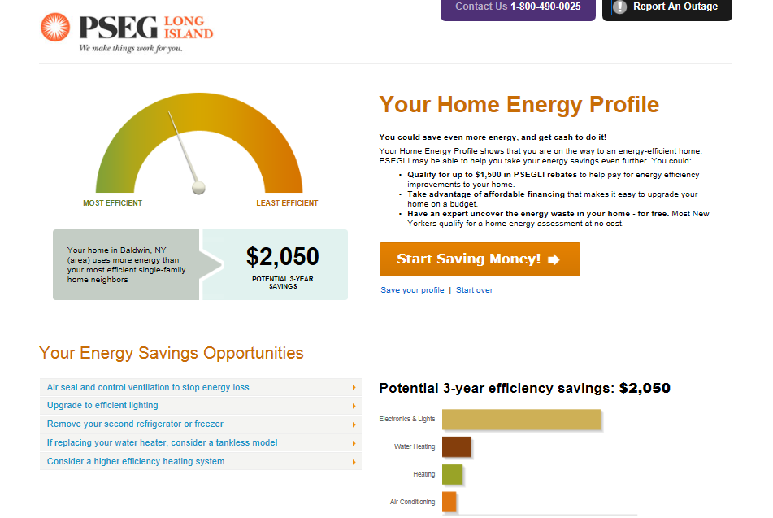
Online Home Energy Profile
www.psegliny.com/efficiency
www.psegliny.com/efficiency
Notes:
Take an easy online survey to get your free Home Energy Profile. If you’d like a Home Energy Assessment at your home, Just click the “Start Saving Money” button to provide your contact information for a representative to call and make an appointment.
The online audit tool is an effective first step that a customer can take to identify potential opportunities to reduce their energy consumption and lower their utility bills.
For the month of August, there is a Best Buy Promotion. Just complete an Online Home Energy Assessment, click the Start Saving Money button, and provide your contact info to be eligible for a $1000 Best Buy gift Card.

Slide 29
The NY Sun Incentive program offers customer incentives for the installation of solar electric systems otherwise known as solar PV (photovoltaic) system
Eligible homeowners can purchase or lease a new solar PV system that converts energy from the sun into electricity while reducing the amount of electricity purchased directly from us.
A state-of-the-art solar PV system is durable, reliable and may last up to 40 years with minimal maintenance.
When combined with New York State and Federal tax incentives make PV more affordable than ever.
Buy a PV System
If you own your home and plan to live there for a while, consider buying a new PV system to generate part or all of your electricity needs for years to come.
Lease a PV System
As an alternative to the up front costs of a new solar system for your home, consider leasing through a Lease Agreement or Power Purchase Agreement (PPA).
Photovoltaic (PV) refers to the direct conversion of sunlight into electricity.
http://www.nyserda.com/Energy-Efficiency-and-Renewable-Programs/Renewables/Solar-Technologies/NY-Sun-Incentive-Program.aspx
Notes:
The NY-Sun Incentive Program makes Solar PV more affordable for Long Island Homeowners.
A solar electric or photovoltaic (PV) system makes good sense and is an investment in your home.
A state-of-the-art solar PV system is durable, reliable and may last up to 40 years with minimal maintenance. NY-Sun incentives combined with New York State and Federal tax incentives make PV more affordable than ever.
The NYSERDA, New York State Energy Research and Development Authority, NY-Sun Incentive Program is administered locally by PSEG Long Island.
To participate, or for more information visit:
Information for Homeowners: http://www.nyserda.ny.gov/Energy-Efficiency-and-Renewable-Programs/Renewables/Solar-Technologies/Solar-PV-Incentive-Program.aspx
Information for Installers: http://www.nyserda.ny.gov/Funding-Opportunities/Current-Funding-Opportunities/PON-2112-Solar-PV-Program-Financial-Incentives.aspx
Consider an energy efficiency audit for your home before installing any renewable energy technology. Find out how to schedule your Comprehensive Home Energy Assessment with a certified Home Performance contractor.

Slide 30
Contacts and Program Resources
Brian Loughlin, Residence Efficiency Program Manager - (516) 404-7596
Linda Schwantner, EEP – (516) 426-9772
Linda Eddy, REAP – (631) 740-0913
Claudia Simicic, Cool Homes - (516) 419-2837
John Herman, HPD and HPwES – (516) 254-3658
Rebate Hotline – (800) 692-2626

